Slide 1
Lecture 1 – Writing Simple Programs
M30299 Programming
School of Computing University of Portsmouth

Slide 2
Introduction to Lecture
This lecture introduces the basic steps involved in programming.
We’ll introduce a simple programming problem (a task to be performed), and then:
work out precisely what the task is;
write down a set of steps (in English) that performs the task;
write these steps as a Python program; and
check that the program works correctly.
We’ll then study the Python program in detail to introduce the basic elements of the Python language.

Slide 3
A programming problem
Consider the following programming problem:
Write a weight converter program that transforms a weight measured in kilos (kilograms) into an equivalent weight in pounds.

Slide 4
Task specification
The first step in writing any program is to make sure that the problem is understood completely.
For the weight conversion problem, we might simply state:
User input: a weight measured in kilos.
Output to screen: a weight measured in pounds, equivalent to the input weight (see next slide).

Slide 5
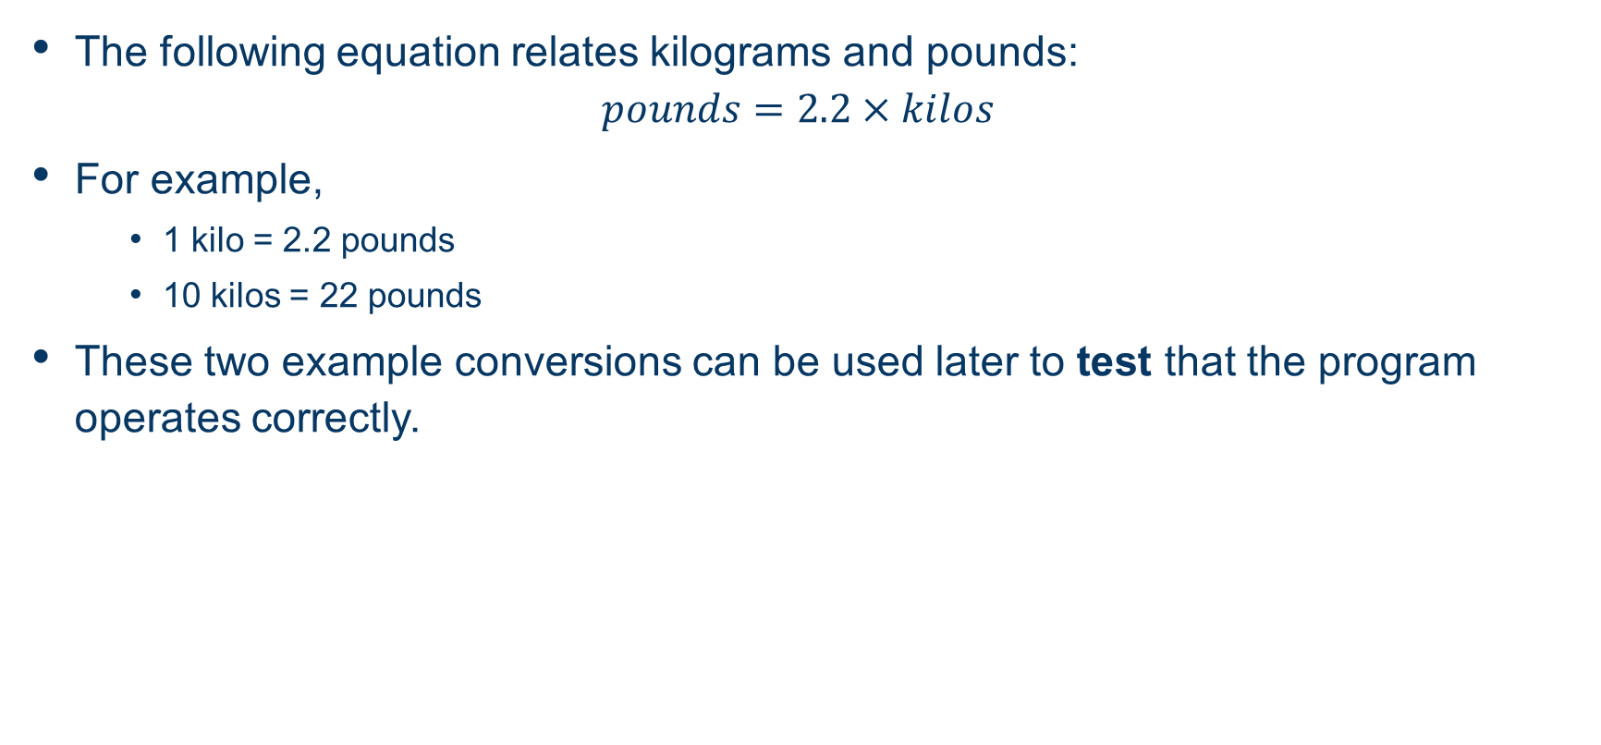
Specification — conversion formula

Slide 6
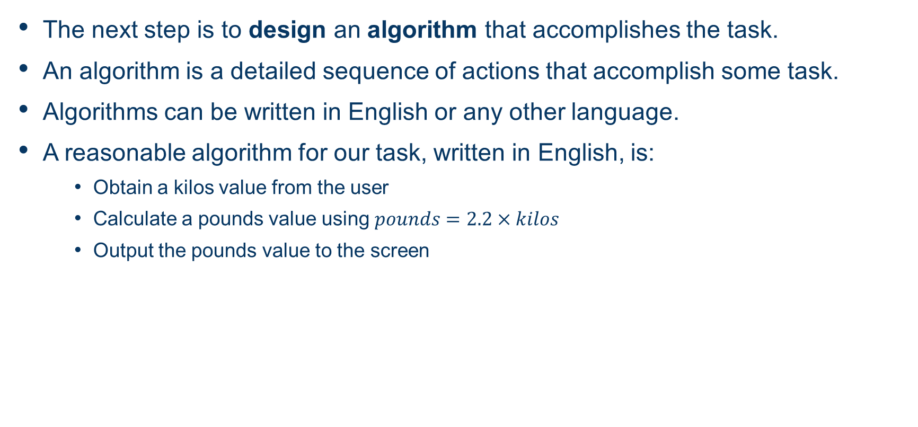
Designing the Algorithm

Slide 7
The Python program
An algorithm like this can be understood/performed by a human.
In can also be written, or implemented, in any programming language like C, Python or Java.
This algorithm is implemented as a Python program as follows:
kilos = float(input("Enter a weight in kilos: "))
pounds = 2.2 * kilos
print("The weight in pounds is", pounds)
We’ll now test this program before studying it in detail.

Slide 8
Testing the program
Let’s test the program to see how it looks to the user, and to check it gives correct results:
Enter a weight in kilos: 1
The weight in pounds is 2.2
Enter a weight in kilos: 10
The weight in pounds is 22.0

Slide 9
Program concepts – statements
Each line of our program is called a command or statement.
The statements of a program are carried out (or executed) one after the other.
Program execution ends after the last statement is executed.
kilos = float(input("Enter a weight in kilos: "))
pounds = 2.2 * kilos
print("The weight in pounds is", pounds)

Slide 10
Program concepts – variables (1)
A variable denotes a part of computer memory where a value is stored.
Variables have names in the program; our program has two variables, kilos and pounds:
kilos = float(input("Enter a weight in kilos: "))
pounds = 2.2 * kilos
print("The weight in pounds is", pounds)

Slide 11
Program concepts – variables (2)
We’ll often draw diagrams to represent the variables and their values in the computer’s memory; for example:
says that kilos has the value 10.0 and pounds has the value 22.0.
A statement in the program may:
create a new variable;
access and use the value of a variable; or
change the value of a variable.
kilos
10.0
pounds
22.0

Slide 12
Program concepts – assignment statements (1)
An assignment statement is used to assign a value to a variable:
The variable appears on the left hand side of the assignment symbol, =.
The right hand side is an expression, which has a value.
There are two assignment statements in our program:
kilos = float(input("Enter a weight in kilos: "))
pounds = 2.2 * kilos
print("The weight in pounds is", pounds)

Slide 13
Program concepts – assignment statements (2)
Assignment statements are executed in two steps; they:
evaluate the expression on the right hand side (i.e. find out its value)
assign this value to the variable on the left hand side.
For example, for the assignment statement:
x = 6 + 4
the following occurs:
the expression 6 + 4 is evaluated to 10
variable x is assigned the value 10.

Slide 14
Program concepts – assignment statements (3)
If the variable on the left hand side doesn’t yet exist, then it is created.
For example, the assignment statement:
y = 2
creates the variable y it doesn't already exist:
Before: After:
x
10
x
10
y
2

Slide 15
Program concepts – assignment statements (4)
Otherwise (if the variable already exists), then its old value is replaced.
For example, the assignment statement:
x = x + y
replaces the old value of x by a new value:
Before: After:
x
10
x
12
y
2
y
2

Slide 16
Program concepts – assignment statements (5)
Two variables can refer to the same value (a concept known as aliasing).
For example, the assignment statement:
x = y
makes x refer to the same value as y.
Before: After:
x
12
x
y
2
y
2

Slide 17
Program concepts – assignment statements (6)
Reassigning one of the variables will remove the aliasing:
y = 15
makes y refer to a new value.
Before: After:
x
x
2
y
2
y
15

Slide 18
Program concepts – numeric and string values
In our program:
kilos = float(input("Enter a weight in kilos: "))
pounds = 2.2 * kilos
print("The weight in pounds is", pounds)
2.2 is an example of a numeric value.
"Enter a weight in kilos: " is a string value.
We can use double or single quotes for strings, but we can’t mix them; so:
"hello" and ’hello’ are OK, whereas:
"hello’ is not!

Slide 19
Program concepts – arithmetic expressions
In our program we have an arithmetic expression:
kilos = float(input("Enter a weight in kilos: "))
pounds = 2.2 * kilos
print("The weight in pounds is", pounds)
Python allows standard arithmetic expressions to be formed from +, -, * (multiplication), /, and brackets ( and ).
An expression is evaluated to give a value.
We’ll study arithmetic expressions in detail in the next lecture.

Slide 20
Program concepts – built-in functions (1)
Our program uses three built-in functions:
kilos = float(input("Enter a weight in kilos: "))
pounds = 2.2 * kilos
print("The weight in pounds is", pounds)
A built-in function is an algorithm that is part of the Python language, and can be accessed by using its name.
The input built-in function:
Displays a prompt on the screen;
Waits for the user to enter a value;
Gives us the value that the user entered.

Slide 21
Program concepts – built-in functions (2)
kilos = float(input("Enter a weight in kilos: "))
pounds = 2.2 * kilos
print("The weight in pounds is", pounds)
The print built-in function displays information to the screen.
We’ll see what the float built-in function does next week, where we introduce data types and study Python’s numeric data types in detail.

